Slide 1
Hotel Application
Authors: Zhaksykeldi M.
Supervisor: Mamen E.

Slide 2
Content
1. Description
2. Technologies
3. UI

Slide 3

Hotel Master This project is a mobile app written on Kotlin. It gives us information about hotels, sorting and finding them by using Rest API.
Description

Slide 4

Kotlin Room Rest API Retrofit Firebase
Technologies

Slide 5
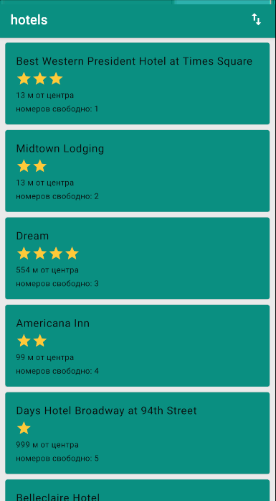
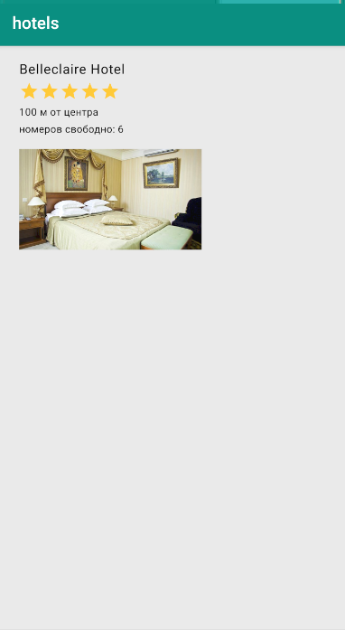
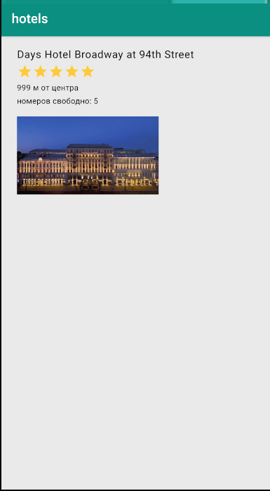
Interface

Slide 6
Thanks for attention!

